Slide 1
An Introduction to Recurrent Neural Networks:

Slide 2
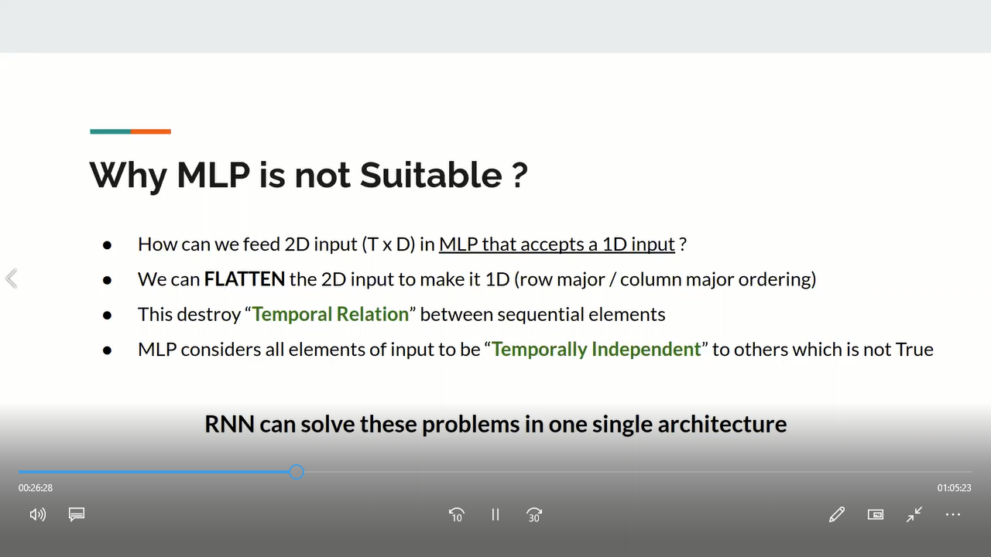

Slide 3
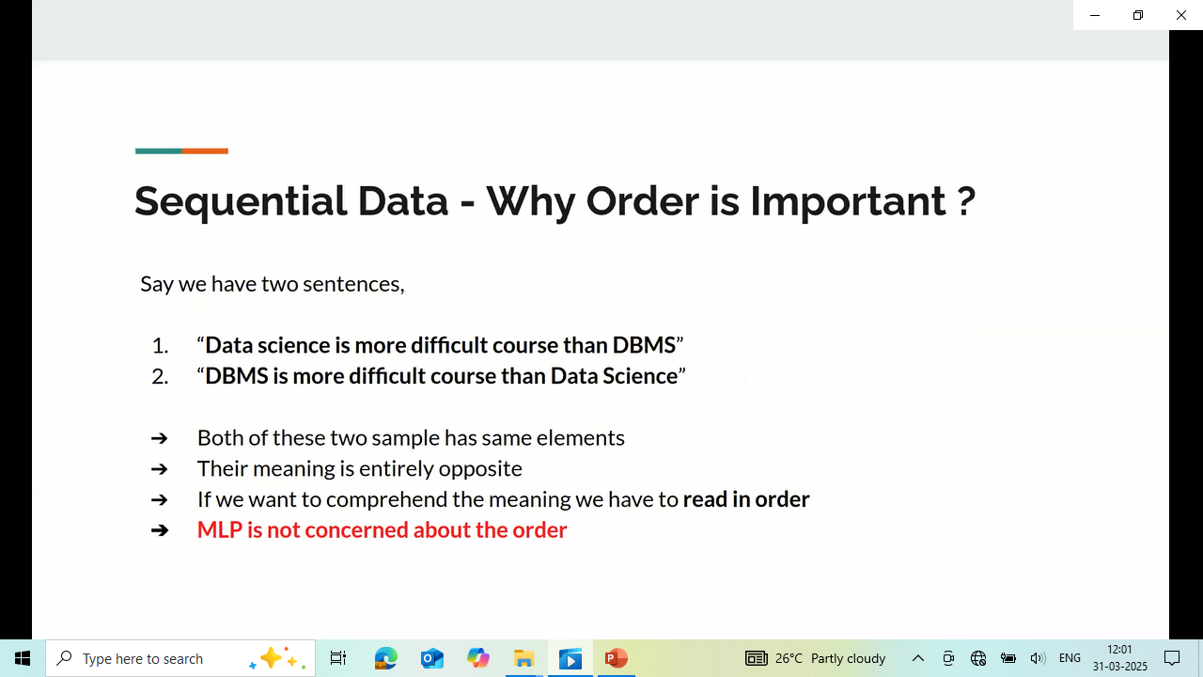

Slide 4
Sequence is a collection of objects in which repetitions are allowed and order matters.
Sequential data examples:
Time series data- ECG, stock market data, seismograph readings
Text data: Word as a sequence of characters, sentences as a sequence of words.
Sensor readings: Online handwriting, daily power consumption
Audio data: Sequence of amplitude values.

Slide 5
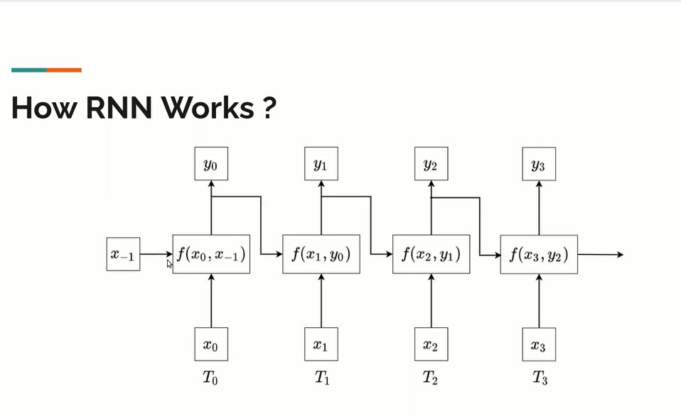

Slide 6
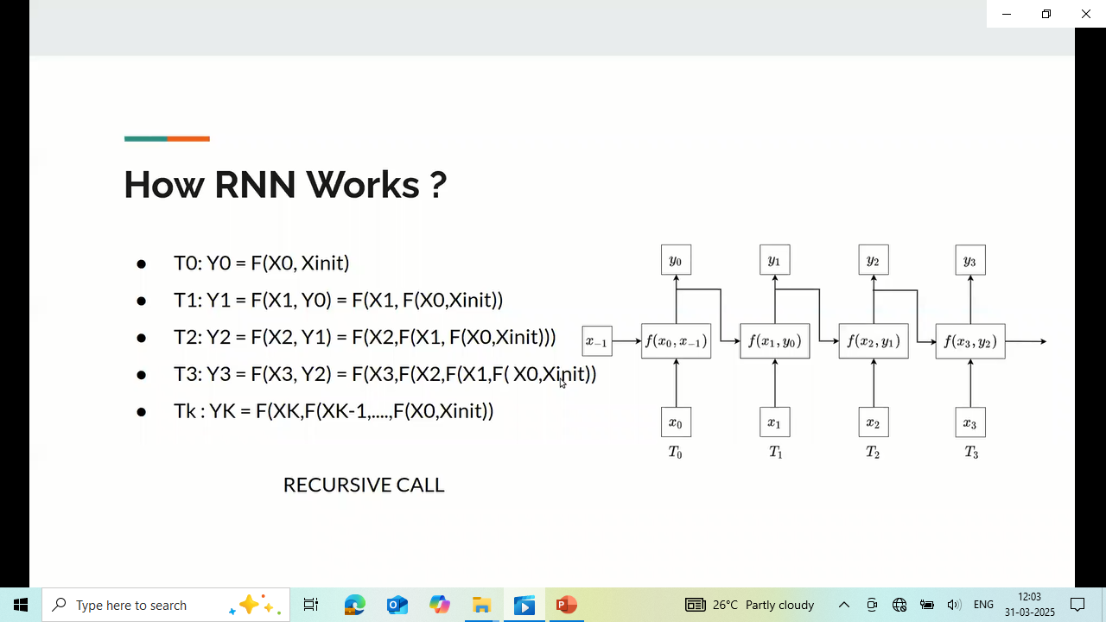

Slide 7
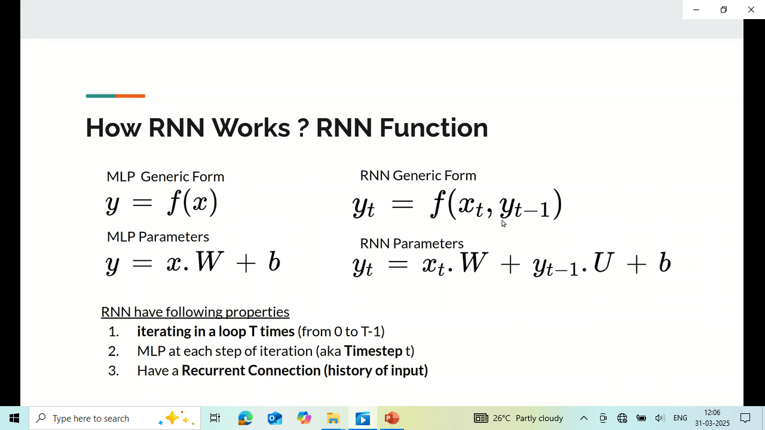

Slide 8
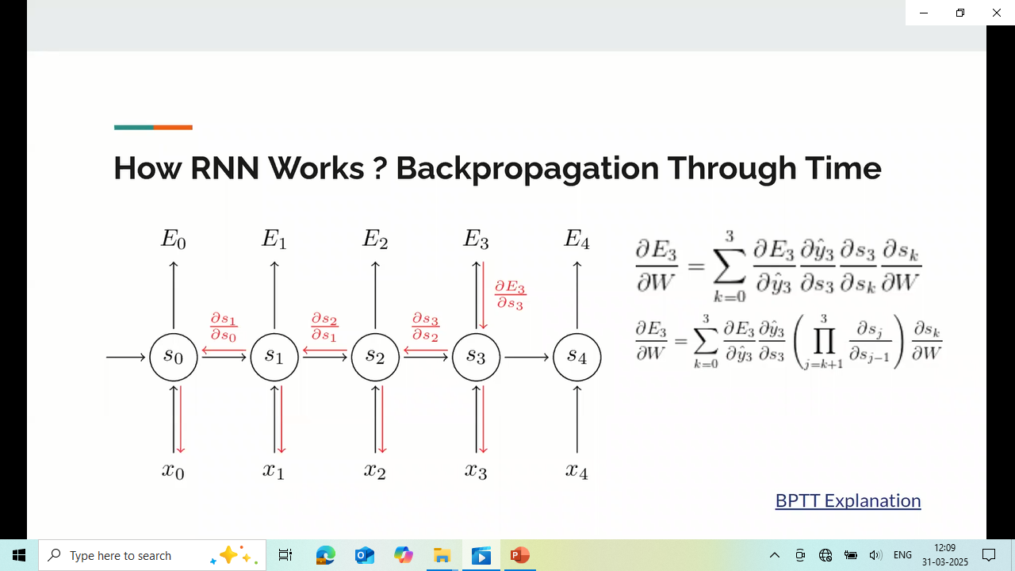

Slide 9
Vanilla RNN
It is a simplest type of RNN, where the hidden state at the current time step is determined by the input at current time step and hidden state from previous time step.

Slide 10
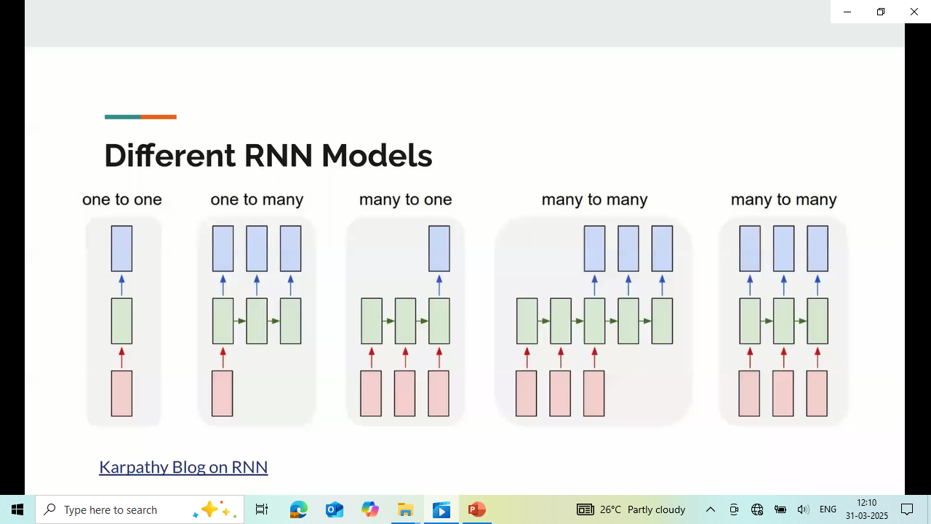

Slide 11
One to one:Input has one time step and output also has one time step.
One to many: Input has one time step and output also has many time steps.
Many to many: Input has one time step output has R time steps (where r is not equal to t).
Many to many: Input has one time step output has R time steps (where r is equal to t).

Slide 12
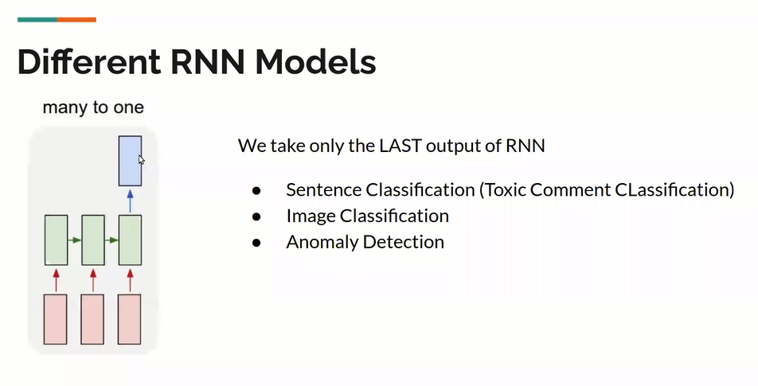

Slide 13
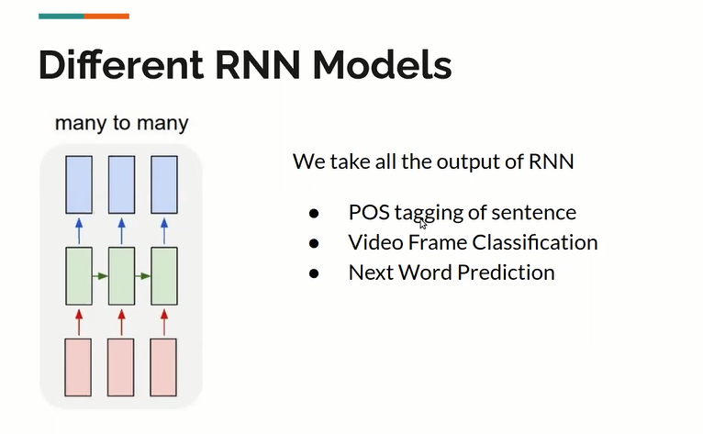

Slide 14
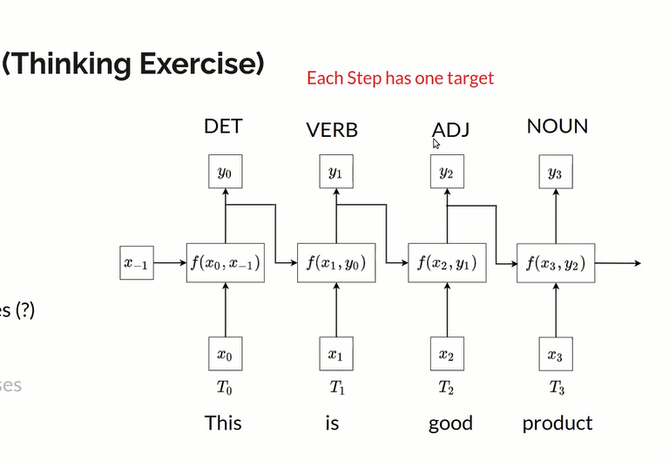

Slide 15
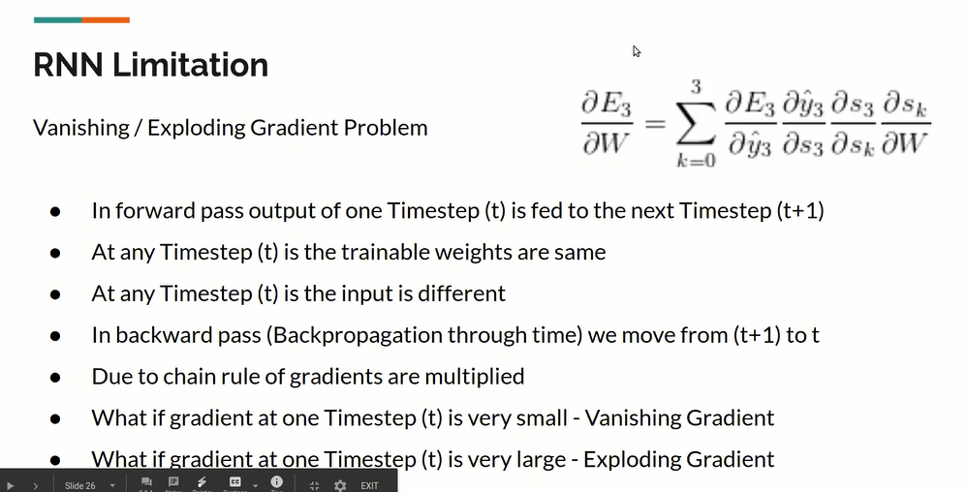

Slide 16
Advantages and Disadvantages of Recurrent Neural Network
Advantages
RNN can model a sequence of data so that each sample can be assumed to be dependent on previous ones.
A recurrent neural network is even used with convolutional layers to extend the active pixel neighborhood.
Disadvantages
Gradient vanishing and exploding problems.
Training an RNN is a complicated task.
It could not process very long sequences if it were using tanh or relu like an activation function.

Slide 17
